Slide 1
STAT 4830 · SPRING 2026
Lower Bounds for the
Autoconvolution Constant
Andrei Piterbarg Jai Bajaj Derrick Vincent

Slide 2
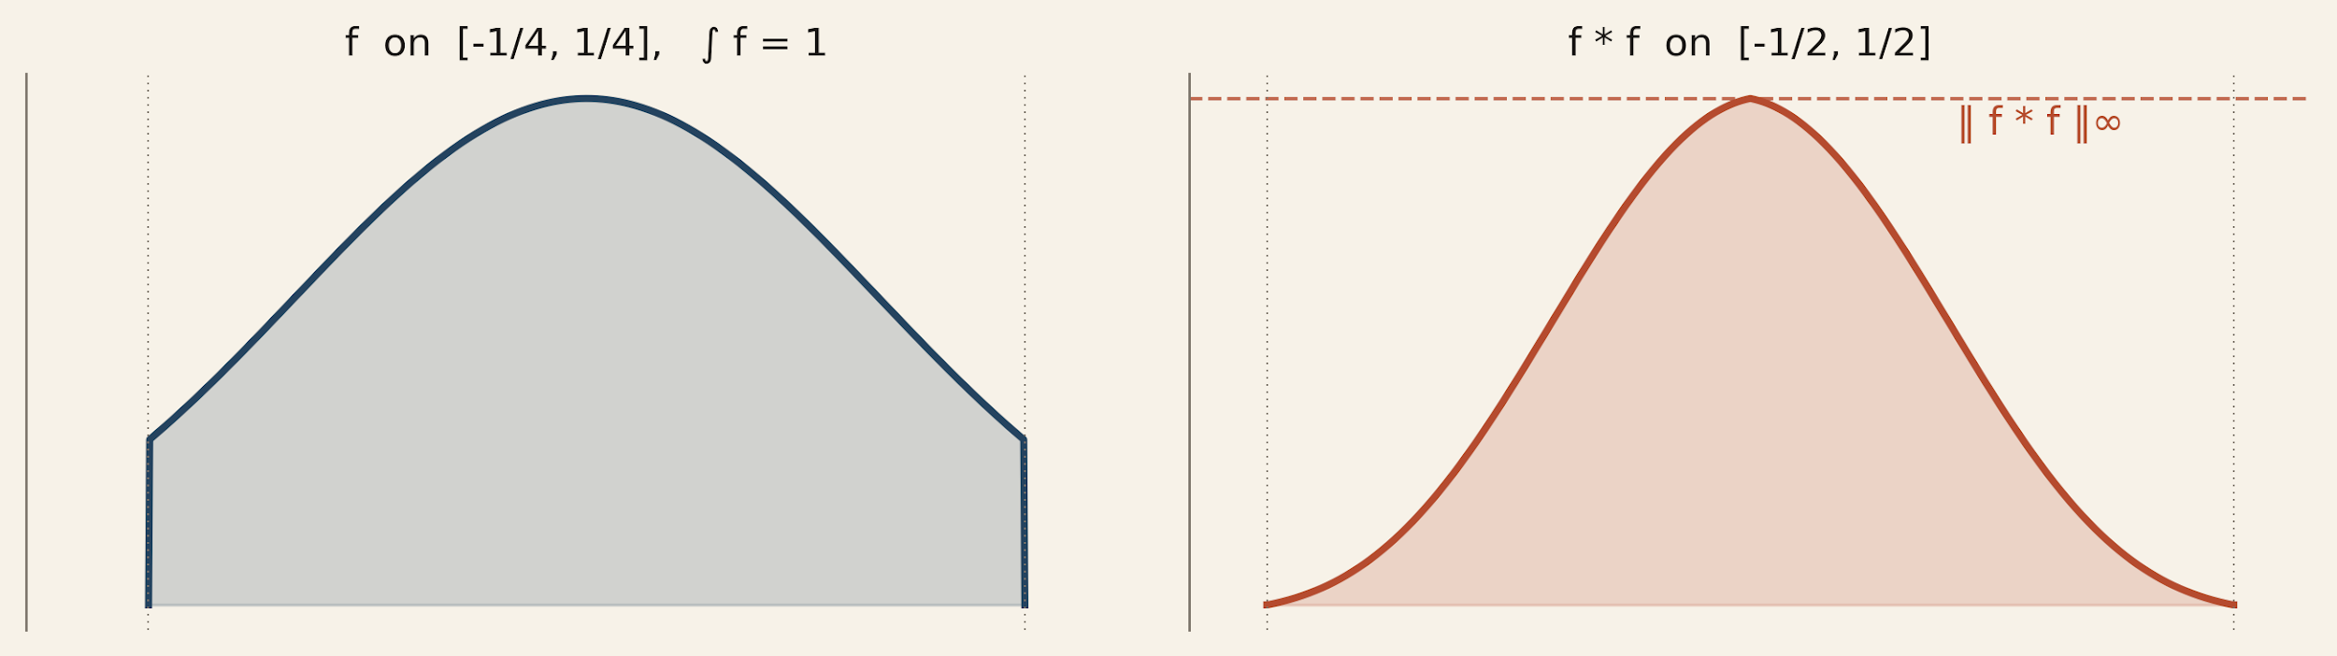
§1 · THE PROBLEM
How small can the peak of a normalized self-convolution be?
Given f : ℝ → ℝ₊ with supp f ⊆ [−¼, ¼]
and ∫ f = 1, define
C₁ₐ = inf ‖ f ∗ f ‖∞
· connected to Sidon / generalized Sidon set densities
· best published bounds have not moved since 2017
· every improvement is a real contribution
BEST PUBLISHED BOUNDS
1.2802 ≤ C₁ₐ ≤ 1.5029 unchanged since 2017
Piterbarg · Bajaj · Vincent STAT 4830 — Spring 2026

Slide 3
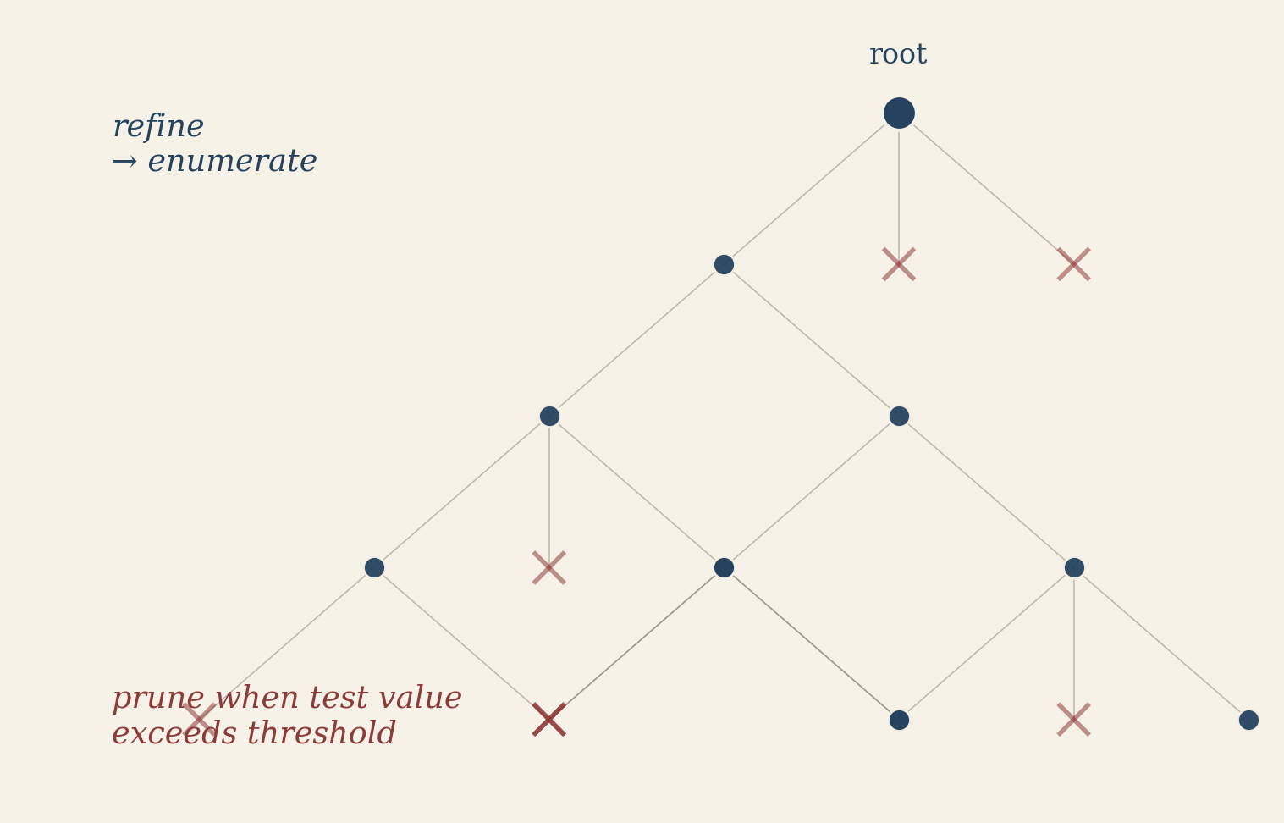
Recursive refinement with novel pruning, fused GPU kernels
CS-Algorithm
1. Discretize - partition [−¼, ¼] into d = 2n bins; approximate f by a step function g with heights in (1/m)ℕ
2. Windowed test values - for each window W, lower-bound ‖f ∗ f‖∞ by a quadratic form in the bin heights
3. Prune - rule out any height vector whose test value exceeds the target threshold
4. Exhaust - if all grid points are pruned, the bound is proved
Novel pruning bounds
· contiguous-block sums catch interior concentrations
· two-max enhanced bound — cross-term dominance
· edge-pair cross-terms c₀ · c_{d−1}
Fused CUDA kernel
· everything on-GPU; no global-memory round trips
· early exit on partial convolution sums (most compositions die cheap)
· two-stage freeze kernel at deep levels — perturbation bound
clears 90 %+ of frozen cases, avoiding warp divergence
· Measured 400 × speedup over the naive enumerator
Led to us proving C₁ₐ ≥ 1.4
at (d, m) = (128, 20)
≈ 70 hours on a 128-core machine
Piterbarg · Bajaj · Vincent STAT 4830 — Spring 2026

Slide 4
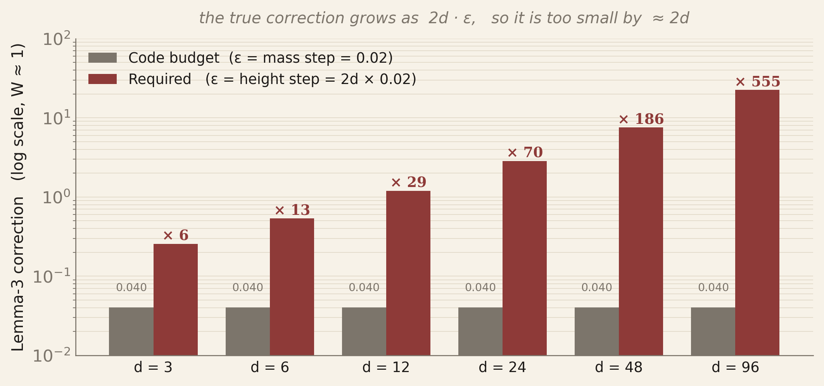
A Critical Discovery
When we set out to improve C₁ₐ ≥ 1.2802 we reached out to Cloninger & Steinerberger and they gave us their source code
We built ontop of the algorithm in this source code. However, while we were writing out Lean proof we discovered that the MATLAB file, did not actually match their formal proof:
C&S Lemma 3 gives: (g ∗ g)(x) ≤ (a ∗ a)(x) + 2ε + ε²
where ε is a bound on ‖g − a‖∞ (a height difference).
In the MATLAB code: ε = 0.02 (mass step), but heights hᵢ = 2d · massᵢ, so the true ‖g − a‖∞ ≤ 2d × 0.02, not 0.02.
The code's pruning budget is too small by a factor of ≈ 2d.
The check:
The best known upper bound is C₁ₐ ≤ 1.5029.
However, using the MATLAB cascade it claimed that C₁ₐ ≥ 1.51
But 1.51 > 1.5029 ≥ C₁ₐ. Contradiction.
Piterbarg · Bajaj · Vincent STAT 4830 — Spring 2026

Slide 5
The paper stands; the shared MATLAB file does not prove it
THE PAPER IS FINE
TWO LIVE HYPOTHESES
C&S 2017 work on the fine height grid Bn,m,
where Lemma 3's 2/m + 1/m² correction is legitimate.
The MATLAB artifact is a different animal:
it enumerates a coarser mass grid, but ports the paper's
correction formula verbatim. That combination
cannot certify the paper's bound, and as shown would
certify bounds that contradict the MV upper bound.
(a) They sent us an early prototype.
The published bound was run on a separate fine-grid
enumerator; the coarse-mass file is a speed-oriented
variant never meant to be the proof vehicle.
(b) A derivation we're missing.
A mass-space bound that avoids the 2d factor —
unlikely, but worth asking about before we conclude.
Piterbarg · Bajaj · Vincent STAT 4830 — Spring 2026

Slide 6
The paper stands; the shared MATLAB file does not prove it
THE PAPER IS FINE
TWO LIVE HYPOTHESES
C&S 2017 work on the fine height grid Bn,m,
where Lemma 3's 2/m + 1/m² correction is legitimate.
The MATLAB artifact is a different animal:
it enumerates a coarser mass grid, but ports the paper's
correction formula verbatim. That combination
cannot certify the paper's bound, and as shown would
certify bounds that contradict the MV upper bound.
(a) They sent us an early prototype.
The published bound was run on a separate fine-grid
enumerator; the coarse-mass file is a speed-oriented
variant never meant to be the proof vehicle.
(b) A derivation we're missing.
A mass-space bound that avoids the 2d factor —
unlikely, but worth asking about before we conclude.
Piterbarg · Bajaj · Vincent STAT 4830 — Spring 2026

Slide 7
An alternate solution
Piterbarg · Bajaj · Vincent STAT 4830 — Spring 2026

Slide 8
An alternate solution
Piterbarg · Bajaj · Vincent STAT 4830 — Spring 2026

Slide 9
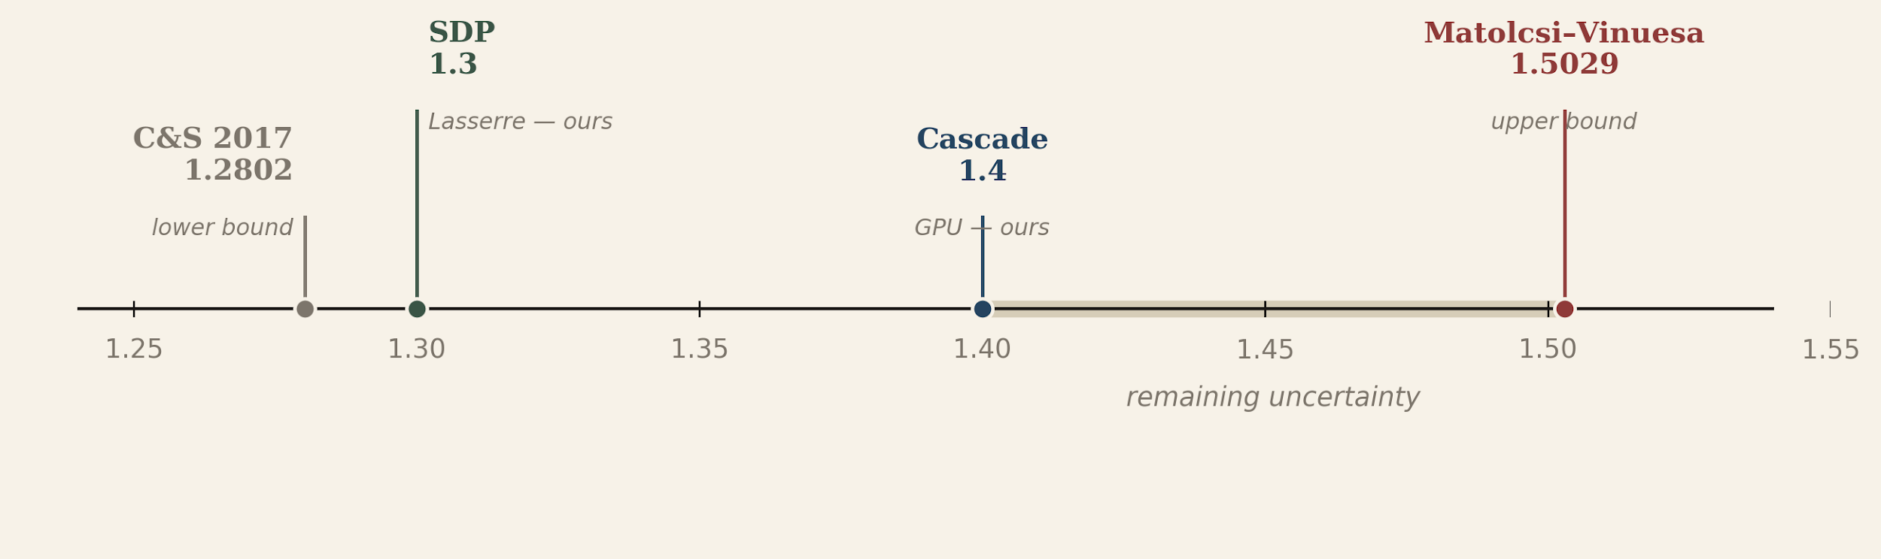
§4 · TAKEAWAYS
Where C₁ₐ stands after this project
THREE DELIVERABLES
Piterbarg · Bajaj · Vincent STAT 4830 — Spring 2026

